Slide 1

Optimization Algorithms
Bias correction
in exponentially
weighted average
deeplearning.ai

Slide 2
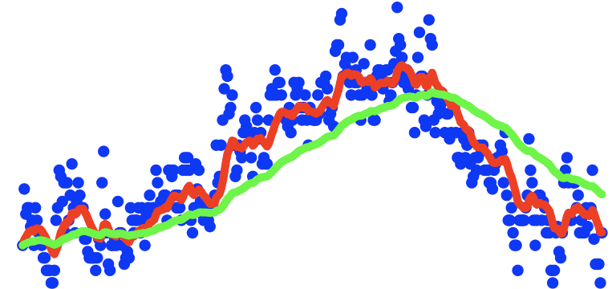
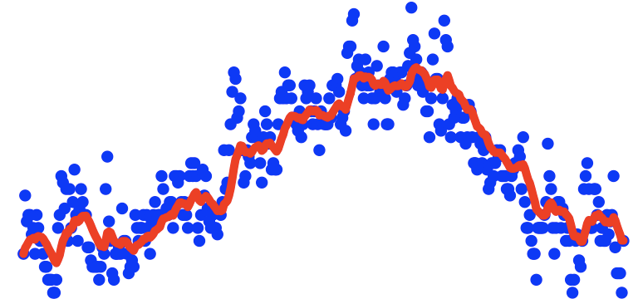
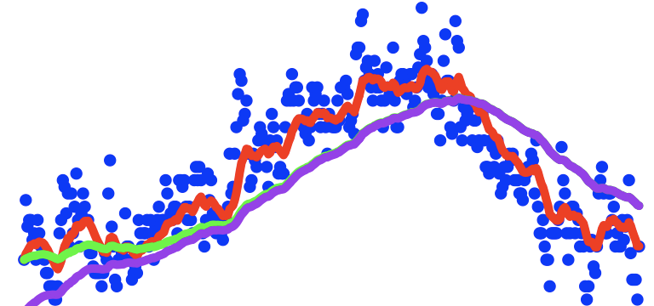
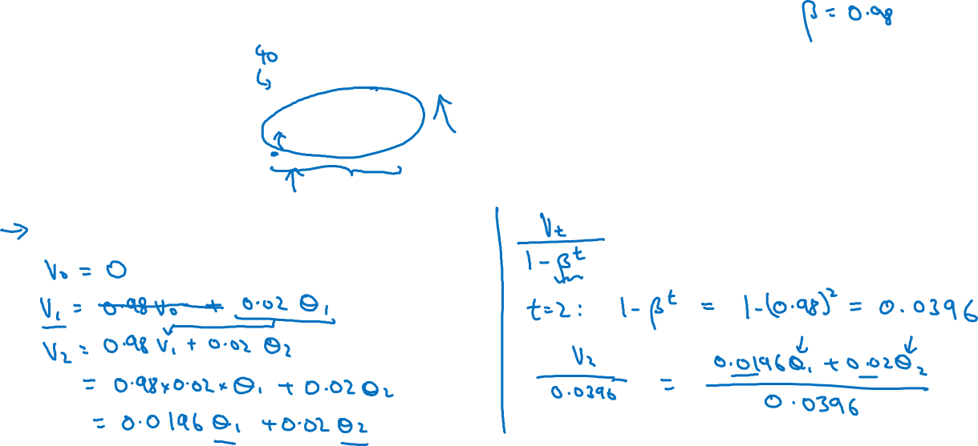

Bias correction
temperature
days
$$v_{t}=βv_{t−1}+(1−β)θ_{t}$$

